Slide 2
Classroom

Slide 3
Pencil

Slide 4
Pen

Slide 5
Paper

Slide 6
Book

Slide 7
Scissors

Slide 8
Notebook

Slide 9
eraser

Slide 10
Pencil Sharpener

Slide 11
Desk

Slide 12
Board

Slide 13
Computer

Slide 14
Chair

Slide 15
backpack

Slide 16
folder

Slide 17
pencil case

Slide 18
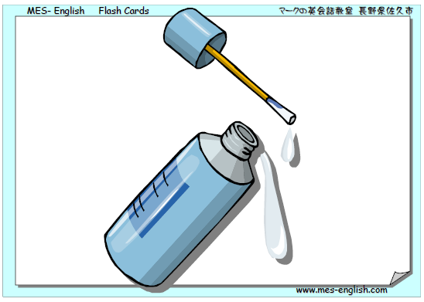
Whiteout / corrector pen

Slide 19
notepad

Slide 20
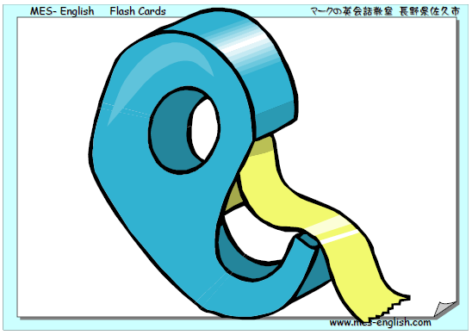
tape

Slide 21
calendar

